Slide 1
Systems Biology Approach Predicts Immunogenicity
of the Yellow Fever Vaccine in Humans
Electra Scarpignato, Ethan Masters, Evan Horvath, Kara Walp
Querec, T., Akondy, R., Lee, E. et al. Systems biology approach predicts immunogenicity of the yellow fever vaccine in humans. Nat Immunol 10, 116–125 (2009). https://doi.org/10.1038/ni.1688

Slide 2

Yellow Fever Vaccine (YF-17D)
Developed in 1930s by Max Theiler
Administered to 600+ million people
Attenuated Asibi strain of yellow fever virus
One of the most effective vaccines ever made
Effective immunity within 30 days for 99%
Model vaccine
Innate immune response
Inform new vaccine design
Subsequent differences in adaptive immunity
https://www.alamy.com/stock-photo/yellow-fever-certificate.html?sortBy=relevant
Notes:
I want more updated stats
https://www.who.int/news-room/fact-sheets/detail/yellow-fever

Slide 3
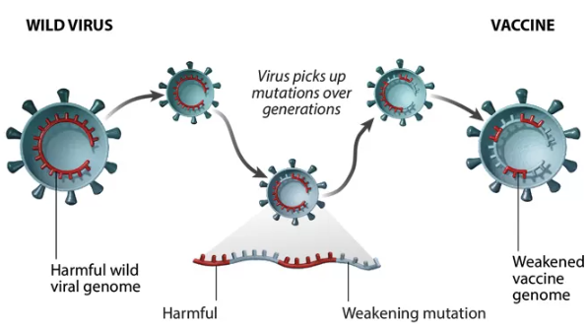

Attenuated Virus Vaccines
Smallpox, polio, measles, mumps
Live attenuated virus
Control viral replication and virulence
Deletion or mutation of replication genes
Safety concerns: potential to revert to original virulence, impaired immunity
Greater efficacy than inactivated virus or subunit vaccines
https://www.pfizer.com/news/articles/understanding_six_types_of_vaccine_technologies
Notes:
Careful about when this stuff was published. Pre-2009 only?
https://www.nature.com/articles/nbt.1635 (2010)

Slide 4
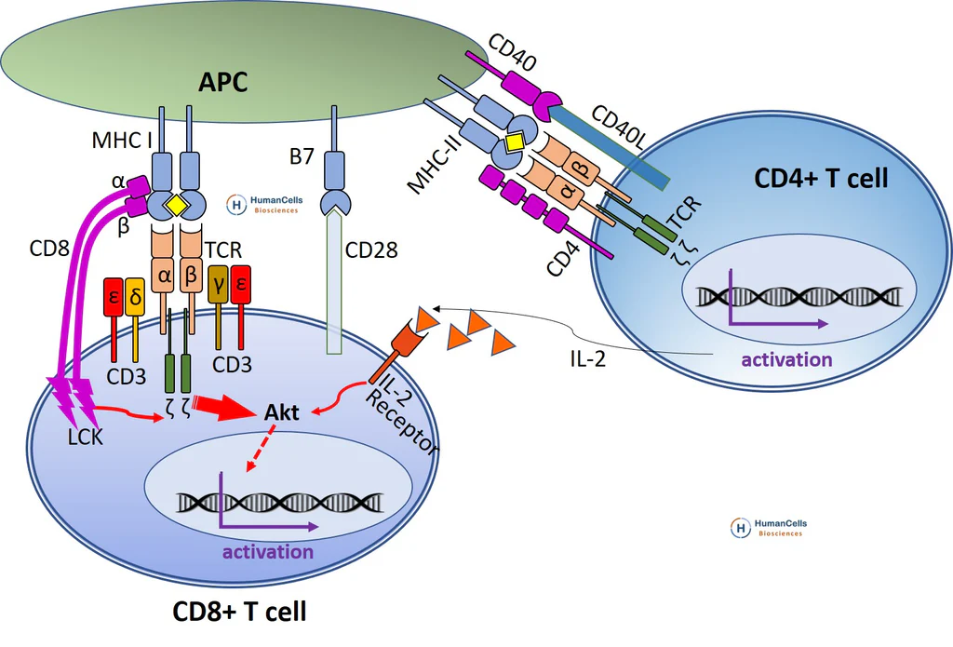
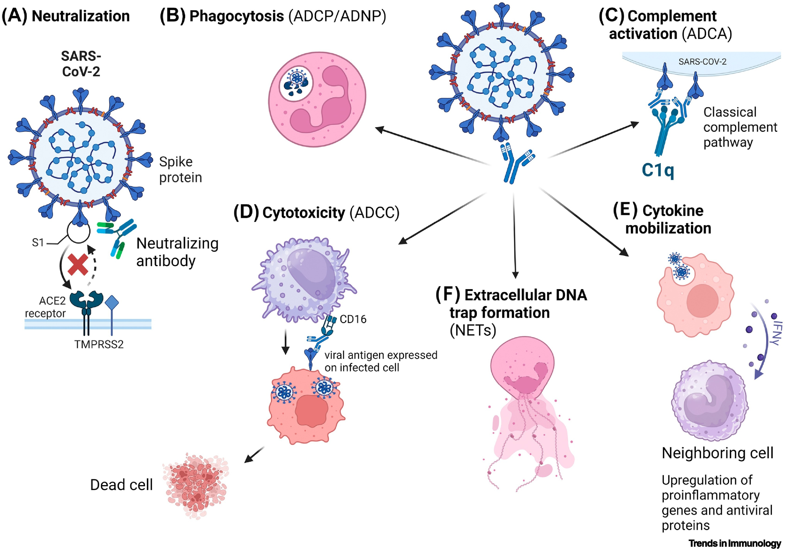
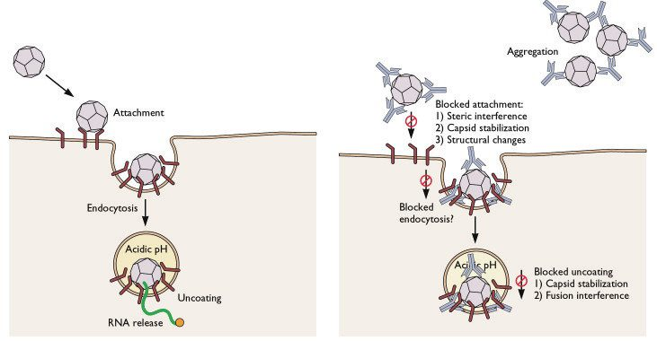
Adaptive Response to YF-17D
Cytotoxic T lymphocytes (CTLs)
T helper type Ⅰ (T_{H}1, CD8⁺) and type Ⅱ (T_{H}2, CD4⁺)
Neutralizing antibodies up to 30 years
Complement pathway
https://humancellsbio.com/products/human-normal-peripheral-blood-cd8-cytotoxic-t-cells?variant=39874997715047
https://www.cell.com/trends/immunology/fulltext/S1471-4906%2824%2900152-2
https://virology.ws/2009/07/24/virus-neutralization-by-antibodies/

Slide 5
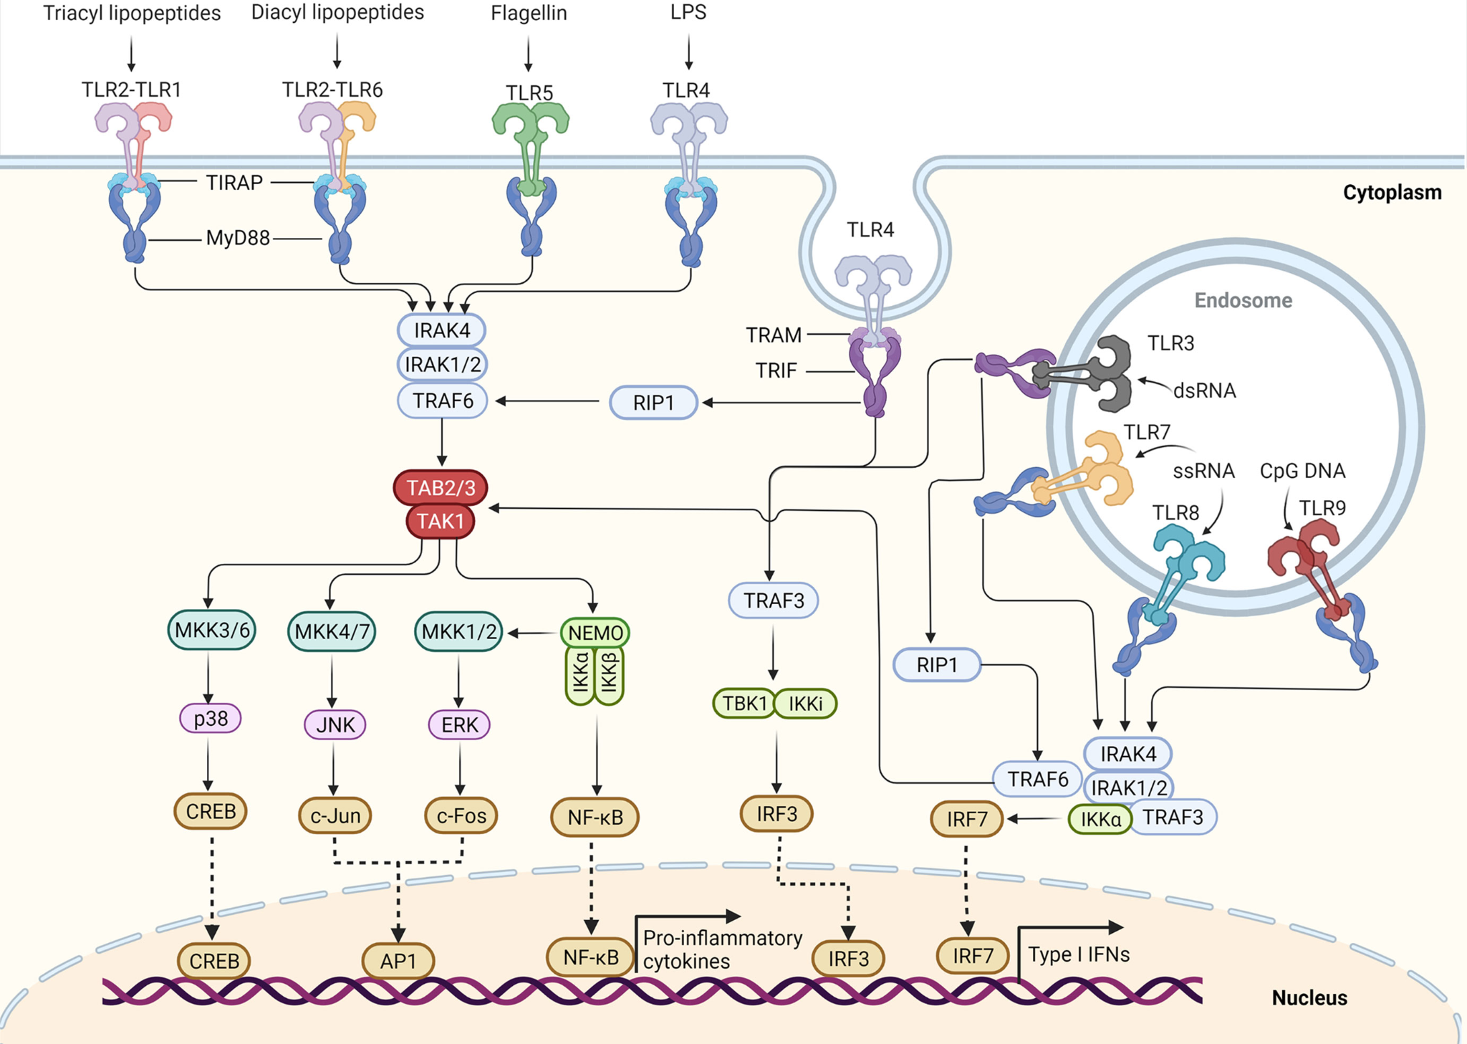
Innate Processes that Influence Adaptive Response
Toll-like receptors (TLRs)
Innate immune cells
Release pro-inflammatory cytokines and/or interferons (IFNs) in response to a virus
Yellow fever has ssRNA: TLR7/TLR8 activation → Type Ⅰ IFNs released
Antigen presenting cells (APCs, DCs)
Janeway, Charles. Immunobiology: The Immune System in Health and Disease. Garland Science, 2005.
Notes:
TLRs https://www.frontiersin.org/journals/immunology/articles/10.3389/fimmu.2022.812774/full
YF is a flavivirus https://www.cdc.gov/yellow-fever/php/transmission/index.html

Slide 6
Goals of the Paper
Conduct multivariate analysis of innate response
Gene expression profiling
Multiplex analysis of cytokines and chemokines
Multiparameter flow cytometry
Computational modeling
Previously utilized for oncology but not for vaccinology
Identify innate immune signatures to predict adaptive immune response
Inform effects of differences in immune systems person to person
Contribution to systems immunology
Notes:
Go into gene expression profiling, cytokines/chemokines, and flow cytometry (and PCR and Antibody titers maybe) also follow the “rubric” more closely

Slide 7
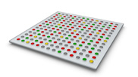
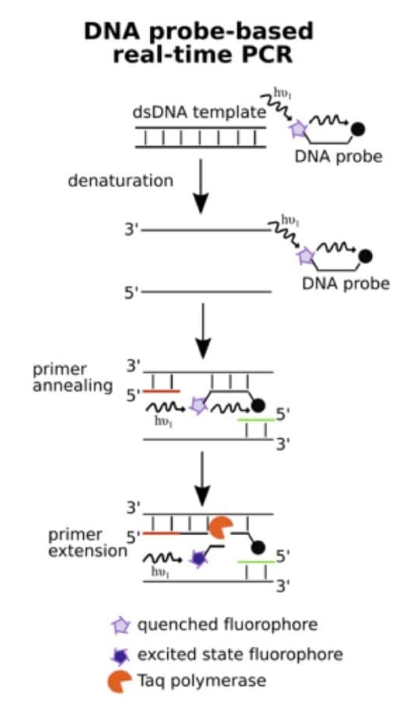
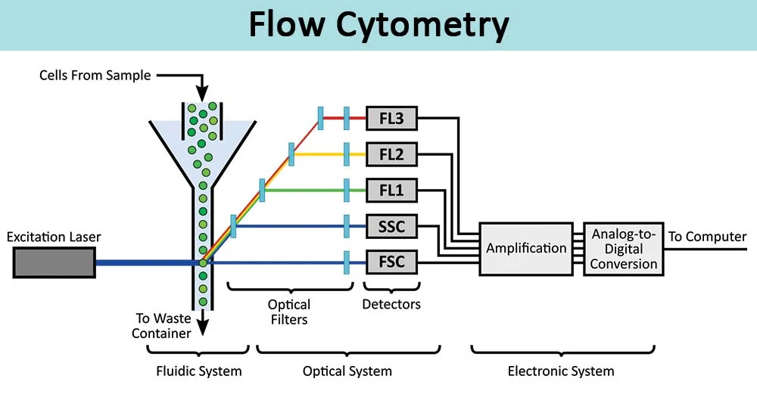
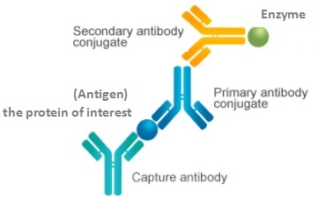
Other Methodologies
https://bitesizebio.com/29508/real-time-pcr-digest/
Gene expression profiling (GEP, transcriptomics)
Microarray
RT-PCR
Multiplex cytokine/chemokine analysis
Enzyme-linked immunosorbent assay (ELISA)
Antibodies
Flow cytometry
https://www.cusabio.com/c-20931.html
https://microbenotes.com/flow-cytometry/
Notes:
https://www.nature.com/scitable/definition/microarray-202/
ELISA https://www.ncbi.nlm.nih.gov/pmc/articles/PMC5659280/

Slide 8
Methodology Overview
Two trials (n=15, n=10) examining the response to YF-17D vaccination
Identified specific genes associated with immune response
Days 1, 3, 7, and 21
Tested if genomic signatures identified in trial 1 predict response in trial 2
Used primarily two methods for classification and prediction
ClaNC
DAMIP
Sought to predict the high and low CD8+ T cell responders
Verified predictions with RT-PCR
Notes:
Talk about validation and PCA
Look into second DAMIP use

Slide 9
ClaNC Overview
Centroid → average of the data points in a cluster
Overall…
Find the averages of each data cluster and classify data points by the nearest neighbor!
Used to classify into high and low responders with 15 genes
Needed 48 genes to accurately classify
Overtrained
Notes:
Nearest Centroid Classifier - EvolkAI
K-means

Slide 10
ClaNC Overview
Centroid → average of the data points in a cluster
Notes:
Nearest Centroid Classifier - EvolkAI
K-means

Slide 11
DAMIP
Discriminant Analysis via Mixed-Integer Programming
Discriminant Analysis
MIP
Notes:
10 fold cv 1, 10-fold blind predictions

Slide 12
Discriminant Analysis Overview
Goal is to determine a discriminant function to differentiate between multiple classes
Low/High responders (T-Cells and antibodies)
Notes:
In n-dimensional space, separated by an n-1 dimensional hyperplane
Discriminant Analysis - Methods, Types and Examples (researchmethod.net)

Slide 13

Mixed-Integer Programming Overview
Common solving method → Branch-and-bound
Begin with linear relaxation → remove integrality restrictions
Solve constraint problem–max or min
Select branching variable
Prune branch that does not maximize/minimize
5.7
Repeat until optimality is reached
>6
<5
…
…
Notes:
Mixed-Integer Programming (MIP) – A Primer on the Basics - Gurobi Optimization
lecture-21.pdf (illinois.edu)

Slide 14
Putting it Together… DAMIP
Assign binary variables to each observation
MIP model shown earlier is used instead of the traditional linear/quadratic discriminant function
2 group classification
Maximize the amount of correctly classified data points
Provides more accurate classification results
Determined 8-14 predictive signatures
Notes:
An iterative mixed integer programming method for classification accuracy maximizing discriminant analysis - ScienceDirect
Second DAMIP use

Slide 15
Advantages and Disadvantages:
ClaNC vs. (DA)MIP
Utility and Feasibility
Notes:
Kara (roughly 10 min) Given that the two main data processing methods used in this paper were ClaNC (Classification by Nearest Centroid) and DAMIP (Discriminant Analysis Mixed Integer Programming), let’s go over the advantages and disadvantages of the two.

Slide 16
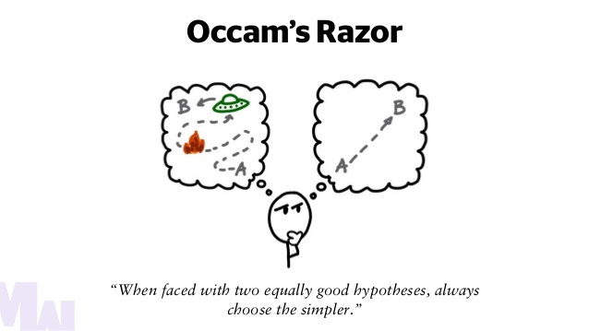
ClaNC: Design & Implementation Advantages
Algorithmic Simplicity
https://automaticaddison.com/occams-razor-and-machine-learning/
Notes:
Kara (roughly 10 min)
Simplicity: ClaNC, like most clustering models, requires much less computational work to train than DAMIP
the philosophical concept of occam’s razor is central to the field of machine learning- the simplest model that can reach a given accuracy is always the best model
we can see from this table that the training runtime of KMeans Clustering mainly depends on:
“k”, the number of clusters (which is low in this application),
“n”, which is the number of samples (also low here)
and “m”, which is dimensions (number of genes per data point), which is also low here
Due to the nature of clustering algorithms, and the nature of this application, ClaNC can theoretically fit high dimensional datasets well without many data points
generally N should be at least 10x K, but this varies case by case (depending on the algorithm and/or the application), and clustering algorithms tend to fall on the lower end of this
ClaNC also did a relatively good job at predicting the CD8+ T-Cell Responses
Good at predicting CD8+ T Cell Responses
successfully identified C1QB as a predictor of CD8+ T Cell responses, to pinpoint critical factors in the immune response, such as those related to complement activation.
Takes Mechanisms of Metabolism into Account
identified the role of glucose metabolism regulators in the immune response, it can capture complex metabolic influences
Identifies Immune Correlates
can reveal new biological pathways, such as stress responses and glucose transport
also, ClaNC is (theoretically) good at analyzing/classifying high dimensional datapoints when there isnt access to alot of training data

Slide 17
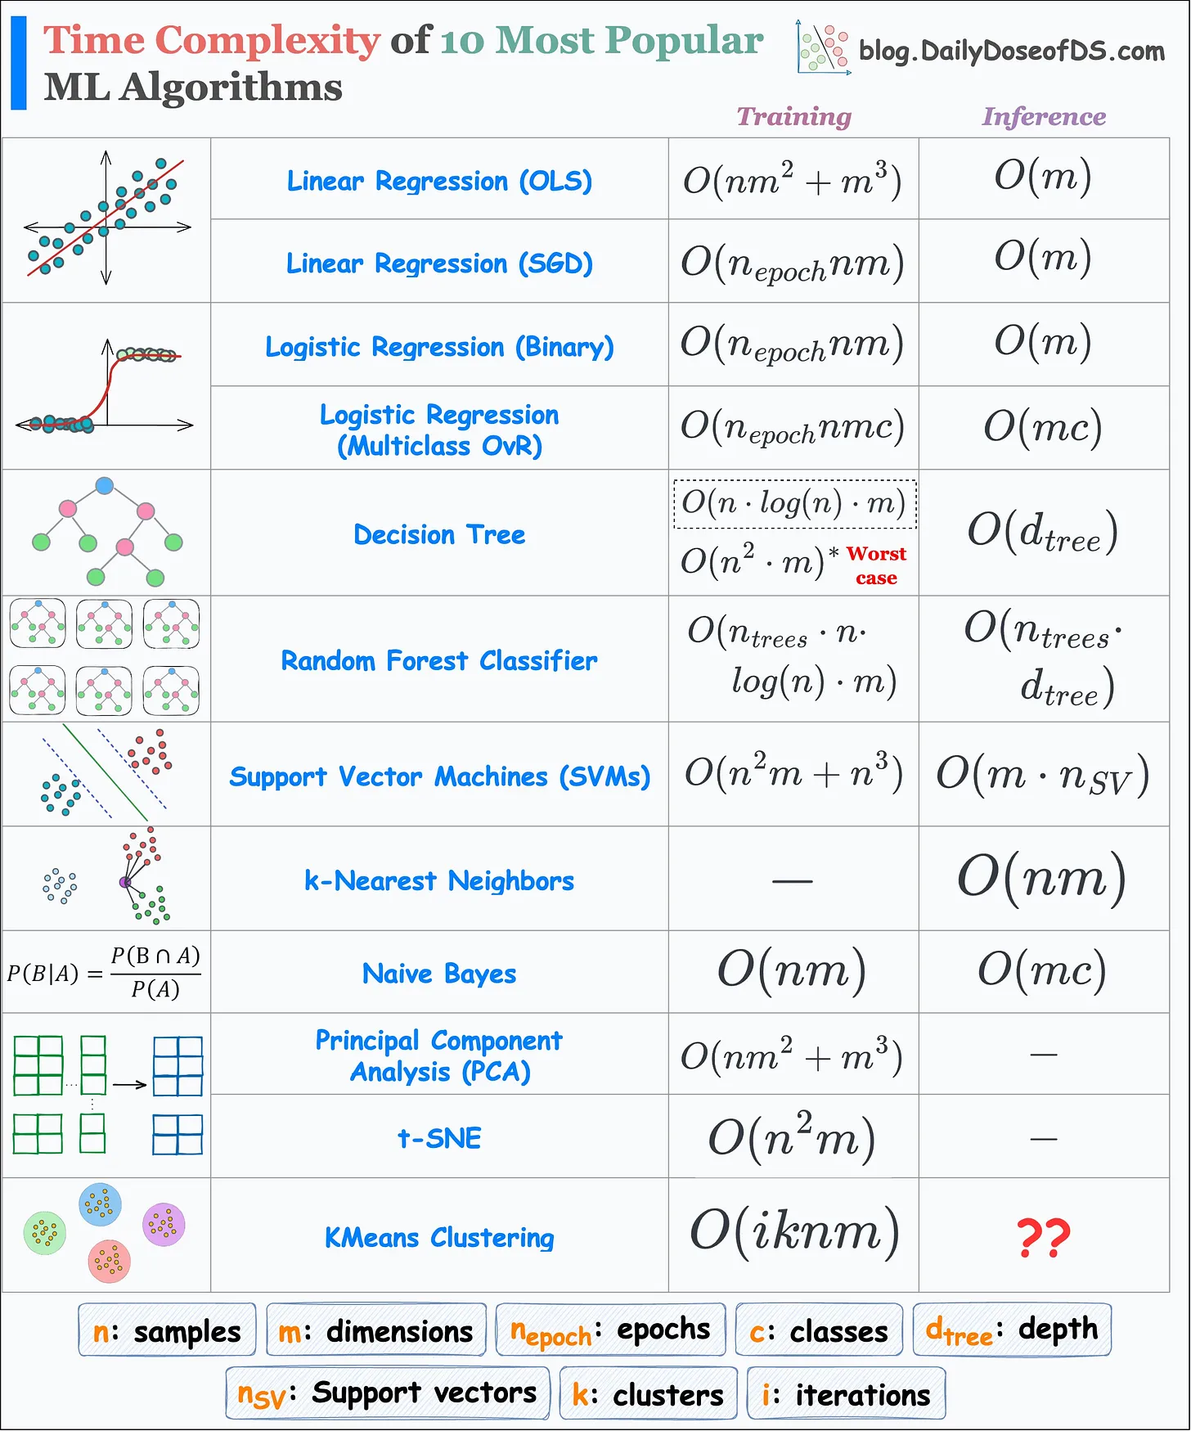
ClaNC: Design & Implementation Advantages
Algorithmic Simplicity
https://blog.dailydoseofds.com/p/training-and-inference-time-complexity
Notes:
Kara (roughly 10 min)
Simplicity: ClaNC, like most clustering models, requires much less computational work to train than DAMIP
the philosophical concept of occam’s razor is central to the field of machine learning- the simplest model that can reach a given accuracy is always the best model
we can see from this table that the training runtime of KMeans Clustering mainly depends on:
“k”, the number of clusters (which is low in this application),
“n”, which is the number of samples (also low here)
and “m”, which is dimensions (number of genes per data point), which is also low here
Due to the nature of clustering algorithms, and the nature of this application, ClaNC can theoretically fit high dimensional datasets well without many data points
generally N should be at least 10x K, but this varies case by case (depending on the algorithm and/or the application), and clustering algorithms tend to fall on the lower end of this
ClaNC also did a relatively good job at predicting the CD8+ T-Cell Responses
Good at predicting CD8+ T Cell Responses
successfully identified C1QB as a predictor of CD8+ T Cell responses, to pinpoint critical factors in the immune response, such as those related to complement activation.
Takes Mechanisms of Metabolism into Account
identified the role of glucose metabolism regulators in the immune response, it can capture complex metabolic influences
Identifies Immune Correlates
can reveal new biological pathways, such as stress responses and glucose transport
also, ClaNC is (theoretically) good at analyzing/classifying high dimensional datapoints when there isnt access to alot of training data

Slide 18
ClaNC: Design & Implementation Advantages
Algorithmic Simplicity
Generally, to prevent overfitting,
N ≥ 10 * k
N = number of data points
k = number of dimensions/features per data point
Less Data Points for Training
Notes:
Kara (roughly 10 min)
Simplicity: ClaNC, like most clustering models, requires much less computational work to train than DAMIP
the philosophical concept of occam’s razor is central to the field of machine learning- the simplest model that can reach a given accuracy is always the best model
we can see from this table that the training runtime of KMeans Clustering mainly depends on:
“k”, the number of clusters (which is low in this application),
“n”, which is the number of samples (also low here)
and “m”, which is dimensions (number of genes per data point), which is also low here
Due to the nature of clustering algorithms, and the nature of this application, ClaNC can theoretically fit high dimensional datasets well without many data points
generally N should be at least 10x K, but this varies case by case (depending on the algorithm and/or the application), and clustering algorithms tend to fall on the lower end of this
ClaNC also did a relatively good job at predicting the CD8+ T-Cell Responses
Good at predicting CD8+ T Cell Responses
successfully identified C1QB as a predictor of CD8+ T Cell responses, to pinpoint critical factors in the immune response, such as those related to complement activation.
Takes Mechanisms of Metabolism into Account
identified the role of glucose metabolism regulators in the immune response, it can capture complex metabolic influences
Identifies Immune Correlates
can reveal new biological pathways, such as stress responses and glucose transport
also, ClaNC is (theoretically) good at analyzing/classifying high dimensional datapoints when there isnt access to alot of training data

Slide 19
ClaNC: Design & Implementation Advantages
Algorithmic Simplicity
can pinpoint factors of immune response (eg. related to complement activation)
can capture complex metabolic influences on immunological response
Less Data Points for Training
T-Cell Response Prediction and Identifying Immune Correlates
Notes:
Kara (roughly 10 min)
Simplicity: ClaNC, like most clustering models, requires much less computational work to train than DAMIP
the philosophical concept of occam’s razor is central to the field of machine learning- the simplest model that can reach a given accuracy is always the best model
we can see from this table that the training runtime of KMeans Clustering mainly depends on:
“k”, the number of clusters (which is low in this application),
“n”, which is the number of samples (also low here)
and “m”, which is dimensions (number of genes per data point), which is also low here
Due to the nature of clustering algorithms, and the nature of this application, ClaNC can theoretically fit high dimensional datasets well without many data points
generally N should be at least 10x K, but this varies case by case (depending on the algorithm and/or the application), and clustering algorithms tend to fall on the lower end of this
ClaNC also did a relatively good job at predicting the CD8+ T-Cell Responses
Good at predicting CD8+ T Cell Responses
successfully identified C1QB as a predictor of CD8+ T Cell responses, to pinpoint critical factors in the immune response, such as those related to complement activation.
Takes Mechanisms of Metabolism into Account
identified the role of glucose metabolism regulators in the immune response, it can capture complex metabolic influences
Identifies Immune Correlates
can reveal new biological pathways, such as stress responses and glucose transport
also, ClaNC is (theoretically) good at analyzing/classifying high dimensional datapoints when there isnt access to alot of training data

Slide 20

ClaNC: Disadvantages
Overfitting
Appropriate
https://www.geeksforgeeks.org/underfitting-and-overfitting-in-machine-learning/
Notes:
Kara (roughly 10 min)
Prone to Overfitting
“overfitting is when a machine learning algorithm becomes too complex to work well in the field. The role of any classification algorithm, especially clustering ones like ClaNC, are to classify data points with optimal accuracy. Usually most of the features (in this case, genes), given to the algorithm pre-train are useless, with the actual classification mostly depending on a few features which correlate with the true classification. When non useful features are given the same weight as useful ones, it leads to the phenomenon of overfitting, where a model can become increasingly complex until it fits the training set perfectly, but does not represent the underlying truth. For any problem, there is an optimal model complexity.
typically in ML, (after PCA), the dimensionality of the data should be reduced to 10% or less of the # of datapoints to prevent overfitting. if a model can’t perform with that, probably there is not enough datapoints, or the data doesn’t contain the correct features required to predict the classification of a datapoint.
ClaNC models must be customized with a lot of detail for applications like the one in this paper, rendering it in need to some adaptation for other applications
Not Great at Gene Role Prediction
ClaNC can identify correlations between specific genes and immune modulation outcome, given that it is a clustering algorithm, but it does not help with identifying mechanisms of said genes

Slide 21
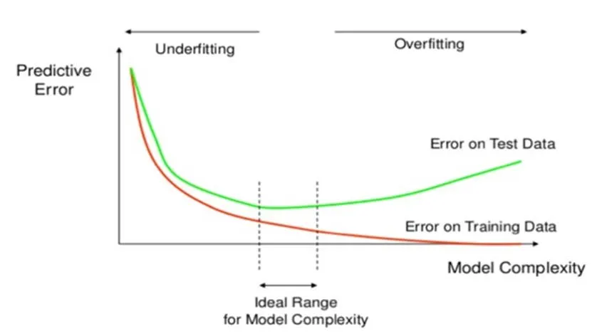
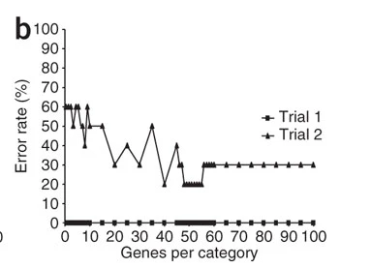
ClaNC: Disadvantages
Overfitting
https://aiml.com/what-is-overfitting/
Notes:
Kara (roughly 10 min)
Prone to Overfitting
“overfitting is when a machine learning algorithm becomes too complex to work well in the field. The role of any classification algorithm, especially clustering ones like ClaNC, are to classify data points with optimal accuracy. Usually most of the features (in this case, genes), given to the algorithm pre-train are useless, with the actual classification mostly depending on a few features which correlate with the true classification. When non useful features are given the same weight as useful ones, it leads to the phenomenon of overfitting, where a model can become increasingly complex until it fits the training set perfectly, but does not represent the underlying truth. For any problem, there is an optimal model complexity.
typically in ML, (after PCA), the dimensionality of the data should be reduced to 10% or less of the # of datapoints to prevent overfitting. if a model can’t perform with that, probably there is not enough datapoints, or the data doesn’t contain the correct features required to predict the classification of a datapoint.
ClaNC models must be customized with a lot of detail for applications like the one in this paper, rendering it in need to some adaptation for other applications
Not Great at Gene Role Prediction
ClaNC can identify correlations between specific genes and immune modulation outcome, given that it is a clustering algorithm, but it does not help with identifying mechanisms of said genes

Slide 22
ClaNC: Disadvantages
Overfitting
Not good at gene role prediction
Identifies correlation between genes and modulation outcome, but not of the innate mechanism
Underlying Mechanism Prediction
Notes:
Kara (roughly 10 min)
Prone to Overfitting
“overfitting is when a machine learning algorithm becomes too complex to work well in the field. The role of any classification algorithm, especially clustering ones like ClaNC, are to classify data points with optimal accuracy. Usually most of the features (in this case, genes), given to the algorithm pre-train are useless, with the actual classification mostly depending on a few features which correlate with the true classification. When non useful features are given the same weight as useful ones, it leads to the phenomenon of overfitting, where a model can become increasingly complex until it fits the training set perfectly, but does not represent the underlying truth. For any problem, there is an optimal model complexity.
typically in ML, (after PCA), the dimensionality of the data should be reduced to 10% or less of the # of datapoints to prevent overfitting. if a model can’t perform with that, probably there is not enough datapoints, or the data doesn’t contain the correct features required to predict the classification of a datapoint.
ClaNC models must be customized with a lot of detail for applications like the one in this paper, rendering it in need to some adaptation for other applications
Not Great at Gene Role Prediction
ClaNC can identify correlations between specific genes and immune modulation outcome, given that it is a clustering algorithm, but it does not help with identifying mechanisms of said genes

Slide 23

DAMIP: Design Advantages
Classification of any number of groups
Large Scale Discrete Optimization
Can incorporate heterogeneous attribute types as input
DAMIP
Support Vector Machines
Pre-training Principal Component Analysis
Reserved-Judgement Region
Notes:
So now on to DAMIP, which is the model that actually worked for these researchers in the end.
DAMIP utillizes large scale discrete optimization, which is a type of optimization, and support vector machines, which are known to be good at solving binary classification problems.
From this, DAMIP gains the following features:
the ability of classify any number of disticnt groups
the ability to incorporate heterogeneous types of attributes as input
a high dimensional data transform that elimintates noise and errors (which we know from the supplementals is PCA)
and a reserved judgement region that provides a safeguard against over training (another name for overfitting)
“Utilizing the technology of large-scale discrete optimization and support-vector machines, we have developed novel predictive models16,17 DAMIP, that simultaneously include the following features: the ability to classify any number of distinct groups; the ability to incorporate heterogeneous types of attributes as input; a high-dimensional data transformation that eliminates noise and errors (some sort of PCA) in biological data; constraints to limit the rate of misclassification, and a reserved-judgment region that provides a safeguard against over-training (which tends to lead to high misclassification rates from the resulting predictive rule); and successive multi-stage classification capability to handle data points placed in the reserved judgment region.
…

Slide 24
DAMIP: Implementation Advantages
This study set it to max of 5
Only 3 at most were needed before target classification rate was met :)
The number of discriminatory gene measurements per signature set
Users can set:
A target value for the threshold classification rate (accuracy)
DAMIP will:
iterate through training cycles
terminate once threshold classification rate is achieved
Notes:
DAMIP is incredibly adaptive and gives users the ability to shift a whole set of parameters based on the application.
Users can pre-set the number of discriminatory gene measurements that are desired in each signature set, meaning they set the number of features that they want DAMIP to train with
Users can also set a target threshold value for the classification training accuracy.
This means that they choose a threshold accuracy rate that DAMIP should reach before terminating its training.
“Since the number of patients in each clinical Trial is rather small, we set each signature set to contain at most 5 gene attributes.”
we will see in the results that the most attributes DAMIP ever needed to use before reaching the desired training accuracy was 3
also note, “note that with ClaNC, 20 genes yielded classification no better than random chance, and 48 genes was needed to even fit the training dataset”
To develop the classification rule from a given training set, the training data is fed into the DAMIP model. The feature selection algorithm inside the model will then determine, out of the large set of gene measurements, a subset of genes – a discriminatory signature -- that may help to classify entities in the training set into the two groups. The classification rate associated with the signature set (obtained by performing ten fold cross validation using the selected signature features) is then recorded. This “learning” process is repeated, each time an updated discriminatory signature set and associated classification rate are obtained and recorded. Users can pre-set the number of discriminatory gene measurements that are desired in each signature set. Since the number of patients in each clinical Trial is rather small, we set each signature set to contain at most 5 gene attributes. (“note that with ClaNC, 20 genes yielded classification no better than random chance, and 48 genes was needed to even fit the training dataset”) (THEY ONLY ACTUALLY USED 3 AT MOST BEFORE THE DESIRED LOSS WAS MET) Users can also pre-set an appropriate target value for the classification rate. Thus the machine will continue to learn (generate signatures sets and associated classification rates) and terminate when the target classification rate is achieved, or when it reaches a level of correct classification and cannot improve any further (in this case, it may not have achieved the pre-set target rate). In our study, the learning process was terminated when the resulting classification rate reached 80%. Developing a classification rule is computationally expensive due to the combinatorial nature of the feature selection process. However, once a rule has been obtained, it is easy and inexpensive to apply it to new unknown entities to predict group membership.

Slide 25
DAMIP: Implementation Advantages
Versatility
Predicted both T Cell and B Cell responses with high accuracy
Comprehensivity
Uses multiple data types to identify a broad span of correlates
Utility
Can identify early vaccine signatures, and is insensitive to prior probability specification
Notes:
In practice, DAMIP
Versatility
DAMIP predicted signatures for T Cell and B Cell responses
Comprehensivity
DAMIP does a really good job at “attacking a problem from every angle”, meaning that its use of multiple data types identifies a broad span of correlates
Utility
Identifies early vaccine signatures, so DAMIP can be deployed while vaccines are still in development
also, a key feature is that it is insensitive to prior probability specification.
In Brooks and Lee, 200817, it was proved the classification rule resulted from DAMIP is strongly universally consistent. It consistently results in low inter-group misclassification rates; it is insensitive to the specification of prior probabilities, yet capable of reducing misclassification rates when the number of training observations from each group is different. Further, the DAMIP rule is proved to be stable regardless of the proportion of training observations from each group.”
figure out what to say about utility
uses less gene signatures (more accurate with less gene signatures)
Since the number of patients in each clinical Trial is rather small, we set each signature set to contain at most 5 gene attributes. (“note that with ClaNC, 20 genes yielded classification no better than random chance, and 48 genes was needed to even fit the training dataset”)
To perform a blind test, simply input each entity from an independent Trial and process it through the classification rule (obtained from a training set). This takes less than a second of CPU time.
In Brooks and Lee, 200817, it was proved the classification rule resulted from DAMIP is strongly universally consistent. It consistently results in low inter-group misclassification rates; it is insensitive to the specification of prior probabilities, yet capable of reducing misclassification rates when the number of training observations from each group is different. Further, the DAMIP rule is proved to be stable regardless of the proportion of training observations from each group.”

Slide 26
DAMIP: Disadvantages
Training Complexity
High amount of computational work required to train DAMIP
Small risk of overfitting, but this is true with almost any model
Overfitting
DAMIP is still much better than ClaNC
Notes:
High Computational Intensity
As is true with most MIP algorithms, DAMIP is very computationally complex to train (despite using less features, the algorithm itself if hard to train
Small risk of Overfitting
The number of features that DAMIP considers makes it prone to overfitting, but this is true of almost any algorithm, and DAMIP is much better in these regards than ClaNC

Slide 27
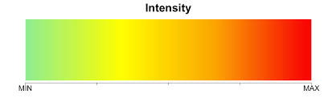
Overall (Qualitative) Comparison of Model Metrics
Metrics | ClaNC | DAMIP
T Cell Response Prediction
B Cell Response Prediction
Specific Pathway Prediction
Broad Analysis
Prone to Overfitting | 48 Features needed for any training accuracy | < 5 Features needed to meet threshold accuracy :)
Lack of Feasibility to Validate Findings
Computational Intensity | ~ O(iknm) training runtime
Good
Bad
Notes:
add color bar
we can see from this qualitative metrics chart that (as well as being the only model that worked), DAMIP is better overall

Slide 28
Results

Slide 29
Can multivariate analysis of innate immune response in humans after vaccination be used to identify gene signatures that sufficiently predict adaptive immune response?
Reiterating research question:
Notes:
Can multivariate analysis of the innate immune response identify innate immune signatures that are sufficient to predict the subsequent adaptive immune response

Slide 30
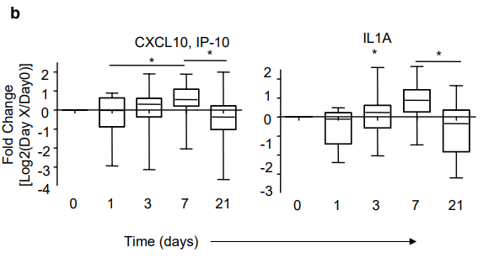
There is a unique innate immune response and gene expression in response to yellow fever vaccine and likely other vaccines
Innate Immune Response Characterization
Induction of cytokines IP-10 and IL1A
Upregulation of CD86 on DCs and monocytes
Notes:
Gen network mediates interferon related antiviral response and complement activation, includes:
Genes involved in viral recognition (IRF7, OAS1, OAS2, OAS3, OASL)
Genes mediating antiviral immunity (CXCL10, MX1)
Complement Genes which also mediate antiviral immunity (SERPING1 and C3AR1)

Slide 31
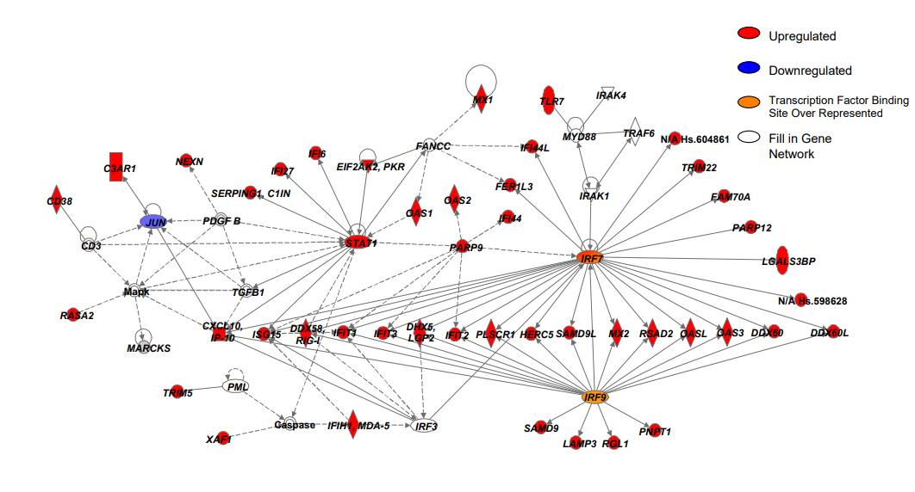
There is a unique innate immune response and gene expression in response to yellow fever vaccine and likely other vaccines
Gene Network
Genes involved in viral recognition, & mediating antiviral immunity (including complement genes)
Notes:
Gen network mediates interferon related antiviral response and complement activation, includes:
Genes involved in viral recognition (IRF7, OAS1, OAS2, OAS3, OASL)
Genes mediating antiviral immunity (CXCL10, MX1)
Complement Genes which also mediate antiviral immunity (SERPING1 and C3AR1)

Slide 32
There is a unique innate immune response and gene expression in response to yellow fever vaccine and likely other vaccines
Given key finding #1: Yellow Fever vaccine induces characterizable innate immune response and network of antiviral genes
Can we predict the adaptive immunes response based on the induced gene expression or innate immune response from YF-17D?
Notes:
Gen network mediates interferon related antiviral response and complement activation, includes:
Genes involved in viral recognition (IRF7, OAS1, OAS2, OAS3, OASL)
Genes mediating antiviral immunity (CXCL10, MX1)
Complement Genes which also mediate antiviral immunity (SERPING1 and C3AR1)

Slide 33
Methods for Results in Key Finding #1
Characterizing Innate Immune Response
Studied protein cytokine response with 24-plex Luminex assay
Time points: 0,1,3,7 and 21 days after vaccination
Flow cytometry analysis to evaluate frequency and activation status of antigen-presenting cells
Obtaining Gene Network
Transcriptional profiling of peripheral blood monocyte nuclear cells (PBMCs)
Trial 1: 15 subjects
Verified with second trial: 10 subjects
Imported genes into Toucan for transcription factor binding site analysis (TFBS)
Visualized gene network with Ingenuity Pathway Analysis
Notes:
PBMCs: Immune cells isolated from peripheral blood: lymphocytes, monocytes, dendritic cells, NK cells
TOUCAN: A software that predicts TFBS
TFBS are DNA regulatory sequences that transcription factors (proteins) bind to, modulating gene expression
Ingenuity Pathway Analysis searches information on genes to build an interacting network based on data from TOUCAN
Given there is a unique innate immune response and network of gene expression in response to the highly effective yellow fever vaccine, what would you expect the adaptive immune response to look like?
Probably a unique adaptive immune response among individuals
Likely a similar response between each person with the yellow fever vaccnine

Slide 34
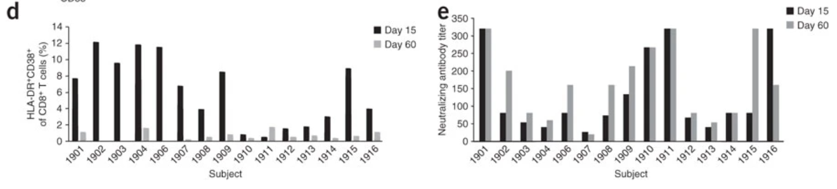
Unique innate immune response and gene expression as result of YF-I7D vaccine cannot predict adaptive immune response
Key finding #2: Adaptive immune responses varied among individuals by more than tenfold
Can potentially predict future response of CD8+ T-cells from early CD8+ T-cell response
Method: Flow cytometry → Magnitude of CD8+ T cell response proportional to HLA-DR+CD38+ population → analyzed CD8+ T cell activation by % of CD38+ HLA-DR+ cells at 15 and 60 days.
Notes:
Flow cytometry tracking CD8+ T cells in vitro using tetramers made with newly identified HLA-A0201 specific epitope showed thar magnitude of (look at method for rest)
Measured amount of antibody titers in blood for figure e
Can we predict adaptive immune response from the characterized innate immune response and gene network for the yellow fever vaccine?
No, no correlation among any of these genes nor the innate immune response on the magnitude of adaptive immune response
Need to identify new predictive gene signatures
Magnitude of CD8+ T cell and antibody response may not be best predictor of vaccine efficacy considering 99% efficacy of yellow fever vaccine, and perhaps there is some other indicator or time-based adaptive immune response that has better potential to correlates with efficacy

Slide 35
Unique innate immune response and gene expression as result of YF-I7D vaccine cannot predict adaptive immune response
Implications/Questions: Why is there such large variation among individuals even with a highly effective vaccine?
Notes:
Flow cytometry tracking CD8+ T cells in vitro using tetramers made with newly identified HLA-A0201 specific epitope showed thar magnitude of (look at method for rest)
Measured amount of antibody titers in blood for figure e
Can we predict adaptive immune response from the characterized innate immune response and gene network for the yellow fever vaccine?
No, no correlation among any of these genes nor the innate immune response on the magnitude of adaptive immune response
Need to identify new predictive gene signatures
Magnitude of CD8+ T cell and antibody response may not be best predictor of vaccine efficacy considering 99% efficacy of yellow fever vaccine, and perhaps there is some other indicator or time-based adaptive immune response that has better potential to correlates with efficacy

Slide 36
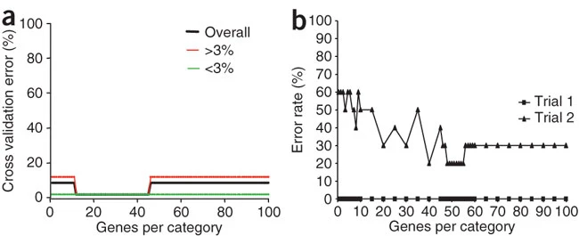
DAMIP is an effective multivariate analysis model in determining correlations between gene expression and adaptive immune response
ClaNC Model Predictions (Fig. 4a,b)
Notes:
DAMIP:
Predictive Signature # at top (Signature is set of 2-3 genes used to make prediction)
Genes listed on left
Bottom: Provides accuracy of predictions with genes. Data was trained on trial 1 to make predictions on trial 2 (signatures 1-8), and vice versa (signatures 1-14)
Notably trial 1 had 15 participants while trial 2 had ten, which may factor into difference in accuracy between predictive training sets.
EIF2AK and SLC2A6 present in both models and especially in DAMIP
ClaNC
Fig a. Shows min number of genes out of 839 identified needed to classify high and low CD8+ T cell response for trial 1 with zero cross validation error (10-45)
Used signatures identified by model to classify vaccines as high or low responding CD8+ T cell response, and results are shown in Fig.b
Needed 48 genes to reach minimum error rate of 20% (over-training)
Less than 20 genes had error rates oscillating around 50% (random guess)
DAMIP: Could be used to predict protective capacity of vaccines and potentially other disease treatments

Slide 37
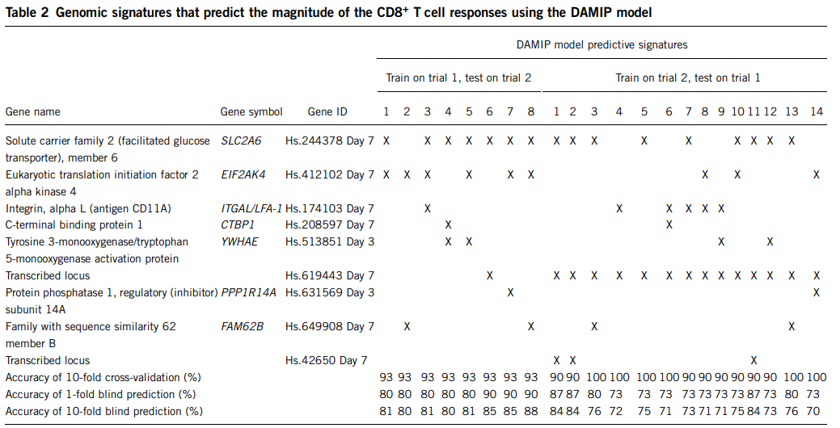
DAMIP is an effective multivariate analysis model in determining correlations between gene expression and adaptive immune response
Notes:
DAMIP:
Predictive Signature # at top (Signature is set of 2-3 genes used to make prediction)
Genes listed on left
Bottom: Provides accuracy of predictions with genes. Data was trained on trial 1 to make predictions on trial 2 (signatures 1-8), and vice versa (signatures 1-14)
Notably trial 1 had 15 participants while trial 2 had ten, which may factor into difference in accuracy between predictive training sets.
EIF2AK and SLC2A6 present in both models and especially in DAMIP
ClaNC
Fig a. Shows min number of genes out of 839 identified needed to classify high and low CD8+ T cell response for trial 1 with zero cross validation error (10-45)
Used signatures identified by model to classify vaccines as high or low responding CD8+ T cell response, and results are shown in Fig.b
Needed 48 genes to reach minimum error rate of 20% (over-training)
Less than 20 genes had error rates oscillating around 50% (random guess)
DAMIP: Could be used to predict protective capacity of vaccines and potentially other disease treatments

Slide 38
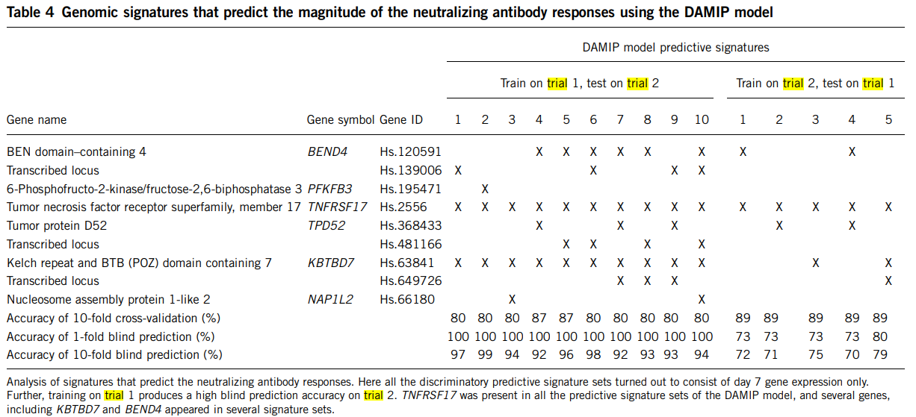
DAMIP is an effective multivariate analysis model in determining correlations between gene expression and adaptive immune response
Notes:
DAMIP:
Predictive Signature # at top (Signature is set of 2-3 genes used to make prediction)
Genes listed on left
Bottom: Provides accuracy of predictions with genes. Data was trained on trial 1 to make predictions on trial 2 (signatures 1-8), and vice versa (signatures 1-14)
Notably trial 1 had 15 participants while trial 2 had ten, which may factor into difference in accuracy between predictive training sets.
EIF2AK and SLC2A6 present in both models and especially in DAMIP
ClaNC
Fig a. Shows min number of genes out of 839 identified needed to classify high and low CD8+ T cell response for trial 1 with zero cross validation error (10-45)
Used signatures identified by model to classify vaccines as high or low responding CD8+ T cell response, and results are shown in Fig.b
Needed 48 genes to reach minimum error rate of 20% (over-training)
Less than 20 genes had error rates oscillating around 50% (random guess)
DAMIP: Could be used to predict protective capacity of vaccines and potentially other disease treatments

Slide 39
DAMIP is an effective multivariate analysis model in determining correlations between gene expression and adaptive immune response
Key Finding #3: Successfully found early gene signatures of innate immune activation that predict T-Cell and antibody response using Independent Classification Methods (DAMIP and ClaNC)
Notes:
DAMIP:
Predictive Signature # at top (Signature is set of 2-3 genes used to make prediction)
Genes listed on left
Bottom: Provides accuracy of predictions with genes. Data was trained on trial 1 to make predictions on trial 2 (signatures 1-8), and vice versa (signatures 1-14)
Notably trial 1 had 15 participants while trial 2 had ten, which may factor into difference in accuracy between predictive training sets.
EIF2AK and SLC2A6 present in both models and especially in DAMIP
ClaNC
Fig a. Shows min number of genes out of 839 identified needed to classify high and low CD8+ T cell response for trial 1 with zero cross validation error (10-45)
Used signatures identified by model to classify vaccines as high or low responding CD8+ T cell response, and results are shown in Fig.b
Needed 48 genes to reach minimum error rate of 20% (over-training)
Less than 20 genes had error rates oscillating around 50% (random guess)
DAMIP: Could be used to predict protective capacity of vaccines and potentially other disease treatments

Slide 40

Obtaining Results (Key Findings 3 & 4)
Identified genes correlated with magnitude of CD8+ T cell response and antibody response
Validated with Unsupervised Principal Component Analysis
Visualize how well identified genes classified subjects into two groups as high or low CD8+ T cell or antibody responders (>3% CD8+ T cell activation was high performing, antibody cutoff was 170 titers)
Tested ability of gene signatures to predict immune response
DAMIP
ClaNC
Verified Genes with RT-PCR
Notes:
Results from key finding one specifically characterized innate immune response from the yellow fever vaccine, which is not the same as CD*+ T cell response and were not correlated with CD8+ T Cell response

Slide 41
Answer to Research Question
Can multivariate analysis of innate immune response in humans after vaccination be used to identify gene signatures that sufficiently predict adaptive immune response?
The innate immune response to YF-17D cannot be used to predict magnitude of adaptive immune response
Early gene signatures associated with CD8+ T-cells and antibodies correlate with the magnitude of immune response
Multivariate analysis with DAMIP can identify gene signatures correlated with adaptive immune response
Notes:
Based on the aforementioned key findings we can sum up our implications to answer the research question:
So to answer the research question, ihe Innate immune response to YF-17D cannot be used to predict the magnitude of adaptive immune response,
However, there are early gene signatures associated with CD8+ T-cells and antibodies, not necessarily a result of the YF-17D vaccine, that correlate with magnitude of the adaptive immune response.
We also demonstrated that multivariate analysis tools were able to identify gene signatures correlated with magnitude of adaptive immune response, and DAMIP was particularly effective

Slide 42
References
“Yellow Fever.” World Health Organization, World Health Organization, 31 May 2023, www.who.int/news-room/fact-sheets/detail/yellow-fever.
Lauring, A., Jones, J. & Andino, R. Rationalizing the development of live attenuated virus vaccines. Nat Biotechnol 28, 573–579 (2010). https://doi.org/10.1038/nbt.1635
Duan, Tianhao, et al. “Toll-like receptor signaling and its role in cell-mediated immunity.” Frontiers in Immunology, vol. 13, 3 Mar. 2022, https://doi.org/10.3389/fimmu.2022.812774.
“Yellow Fever Vaccine.” Centers for Disease Control and Prevention, Centers for Disease Control and Prevention, 15 May 2024, www.cdc.gov/yellow-fever/php/transmission/index.html.
“Microarray.” Nature News, Nature Publishing Group, 2014, www.nature.com/scitable/definition/microarray-202/.
Chiswick, Evan L., et al. “Detection and quantification of cytokines and other biomarkers.” Methods in Molecular Biology, vol. 844, 21 Dec. 2011, pp. 15–30, https://doi.org/10.1007/978-1-61779-527-5_2.
Janeway, Charles. Immunobiology: The Immune System in Health and Disease. Garland Science, 2005.
Ghosh N, Santoni D, Saha I, Felici G. Predicting Transcription Factor Binding Sites with Deep Learning. Int J Mol Sci. 2024 May 3;25(9):4990. doi: 10.3390/ijms25094990. PMID: 38732207; PMCID: PMC11084193.
Glen J.J. An iterative mixed integer programming method for classification accuracy maximizing discriminant analysis. Computers & Operations Research. 2003 February 30;2. https://doi.org/10.1016/S0305-0548(01)00088-0
Hassan M. “Discriminant Analysis - Methods, Types and Examples.” Research Method, August 15, 2023. https://researchmethod.net/discriminant-analysis/.
Kleiveland CR. Peripheral Blood Mononuclear Cells. In: Verhoeckx K, Cotter P, López-Expósito I, et al., editors. The Impact of Food Bioactives on Health: in vitro and ex vivo models [Internet]. Cham (CH): Springer; 2015. Chapter 15. Available from: https://www.ncbi.nlm.nih.gov/books/NBK500157/ doi: 10.1007/978-3-319-16104-4_15
“Mixed-Integer Programming (MIP) – A Primer on the Basics.” Gurobi Optimization, August 30, 2024. https://www.gurobi.com/resources/mixed-integer-programming-mip-a-primer-on-the-basics/.
“Nearest Centroid Classifier.” EvolkAI. Accessed September 24, 2024. https://evolkai.com/nearest-centroid.
https://automaticaddison.com/occams-razor-and-machine-learning/
https://blog.dailydoseofds.com/p/training-and-inference-time-complexity
https://www.geeksforgeeks.org/underfitting-and-overfitting-in-machine-learning/

Slide 43
Thank you!
Any Questions?

